Slide 1
AWS Project: Securing Cloud Resources
Project Report
Mohammed Ibrahim Hamissa AWS Cloud Solutions Admin and Architect ALX1-ISS4-M1e October, 2024

Slide 2
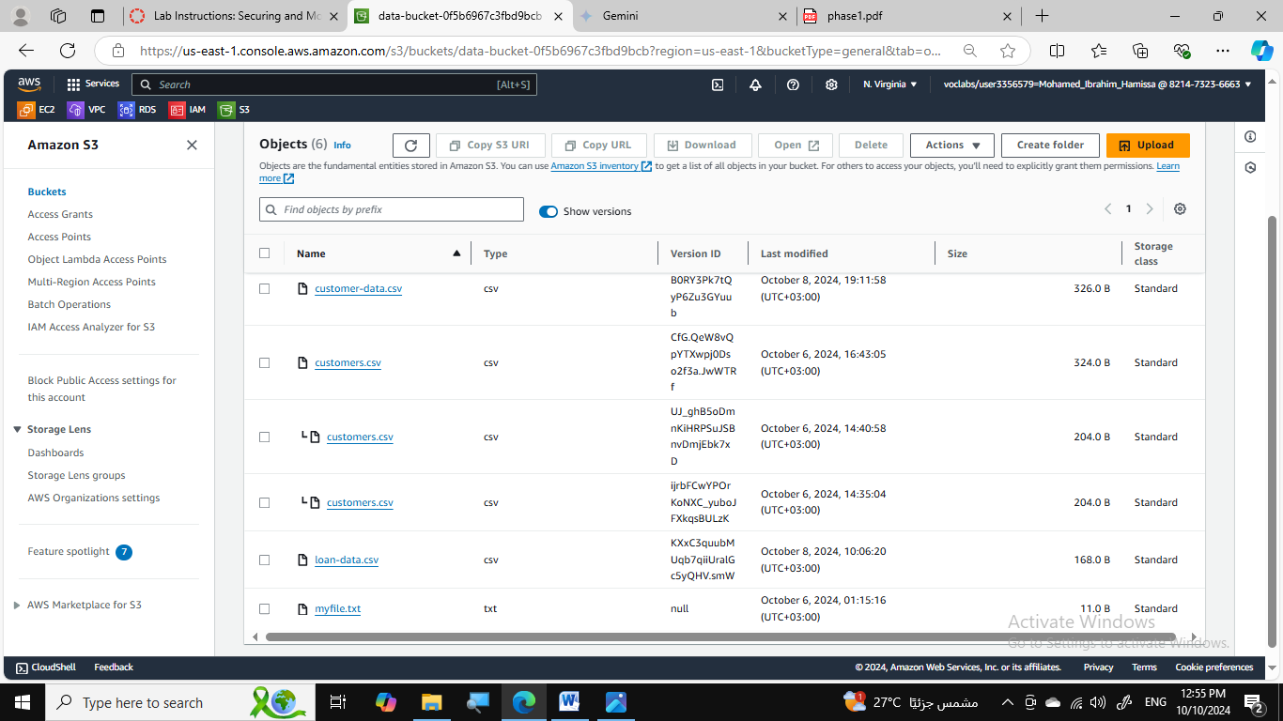
Phase 1: Securing Data in Amazon S3
Created a new S3 bucket named data-bucket-0f5b6967c3fbd9bcb
Applied a bucket policy to restrict access to authorized users.
Enabled versioning on the data-bucket to track object changes. (figure)
Enabled object-level logging to record detailed access information.

Slide 3
Phase 1: Securing Data in Amazon S3
Configured S3 Inventory to monitor object changes and generate reports.
Verified that versioning and object-level logging are working as expected.
Tested access to different versions of the customers.csv file.
Created an Athena table to query access logs.
Retrieved log data for specific actions, such as uploading and downloading the customers.csv file.

Slide 4
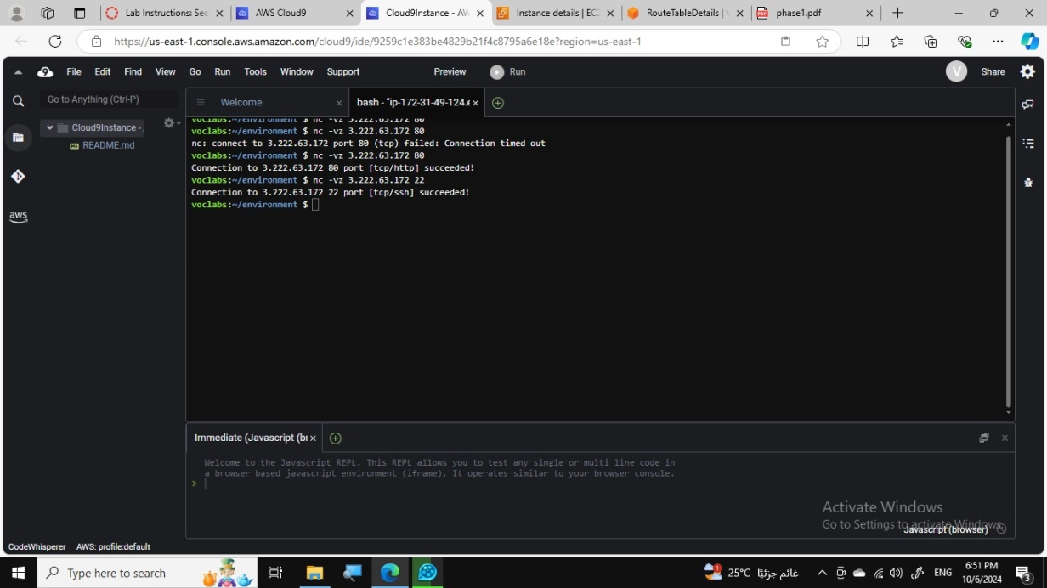
Phase 2: Securing VPCs
Analyzed the existing LabVPC resources, including subnets, route table, and internet gateway.
Created a VPC flow log for LabVPC to capture network traffic information.
Tested access to the WebServer instance from the internet. (figure)
Reviewed VPC flow logs to analyze network traffic patterns.

Slide 5
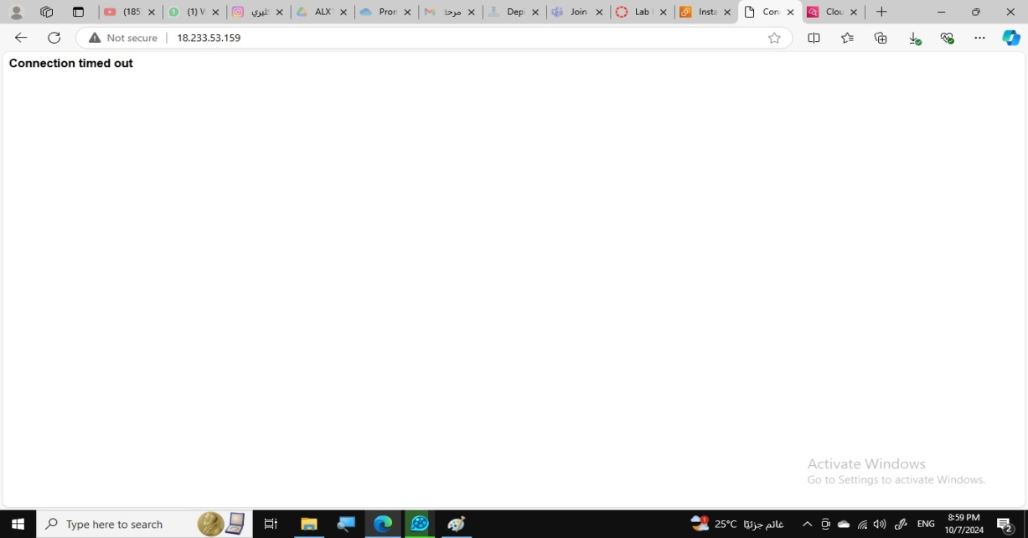
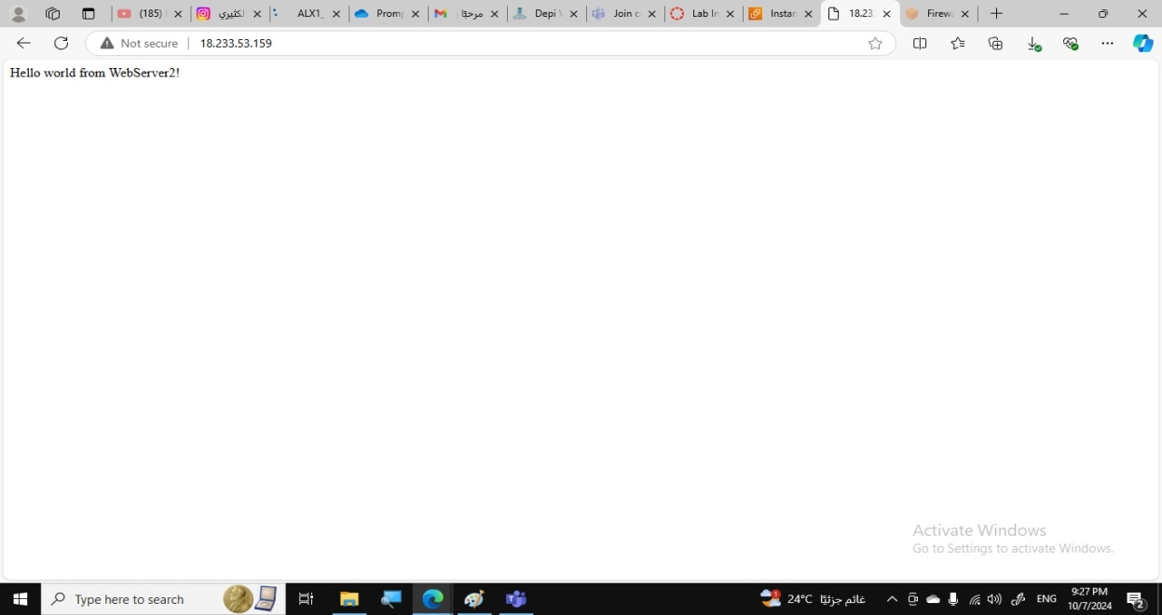
Phase 2: Securing VPCs
Modified the route table to allow internet traffic to the WebServerSubnet.
Configured the security group to allow inbound traffic on ports 80 and 22.
(figures)
Created a network ACL for the WebServerSubnet to provide an additional layer of security.

Slide 6
Phase 2: Securing VPCs
Created a stateful rule group with rules to allow specific traffic and deny others.
Tested access to the WebServer2 instance after applying the firewall policy.
Created a network firewall named NetworkFirewall for the NetworkFirewallVPC.
Created route tables for the FirewallSubnet and WebServer2Subnet.
Configured routes to direct traffic to the internet gateway through the firewall.
Configured logging for the network firewall to monitor network traffic requests.
Analyzed the NetworkFirewallVPC resources, including subnets, internet gateway, and network ACL.

Slide 7
Phase 3: Securing AWS Resources Using AWS KMS
Created a customer managed key named MyKMSKey.
Configured automatic key rotation for the key.
Modified the key policy to allow the sofia user to use the key.
Analyzed the IAM policy for the sofia user to verify permissions.
Updated the data-bucket encryption settings to use SSE-KMS.
Uploaded the loan-data.csv file to the data-bucket.
(following figures)

Slide 8
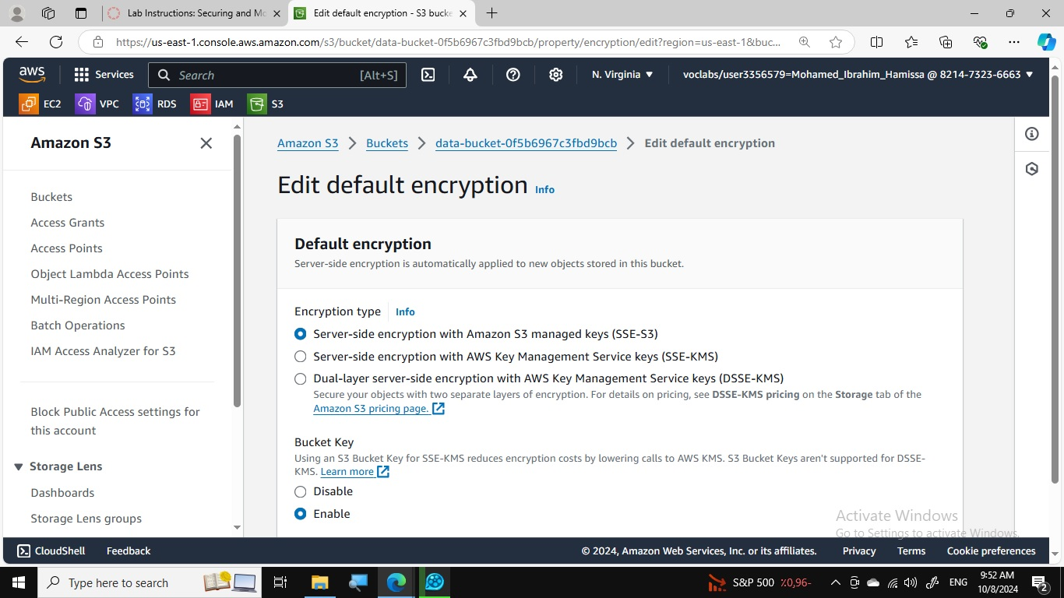
Phase 3: Securing AWS Resources Using AWS KMS

Slide 9
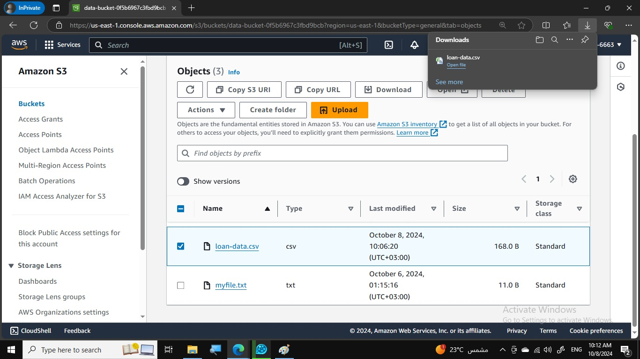
Phase 3: Securing AWS Resources Using AWS KMS

Slide 10
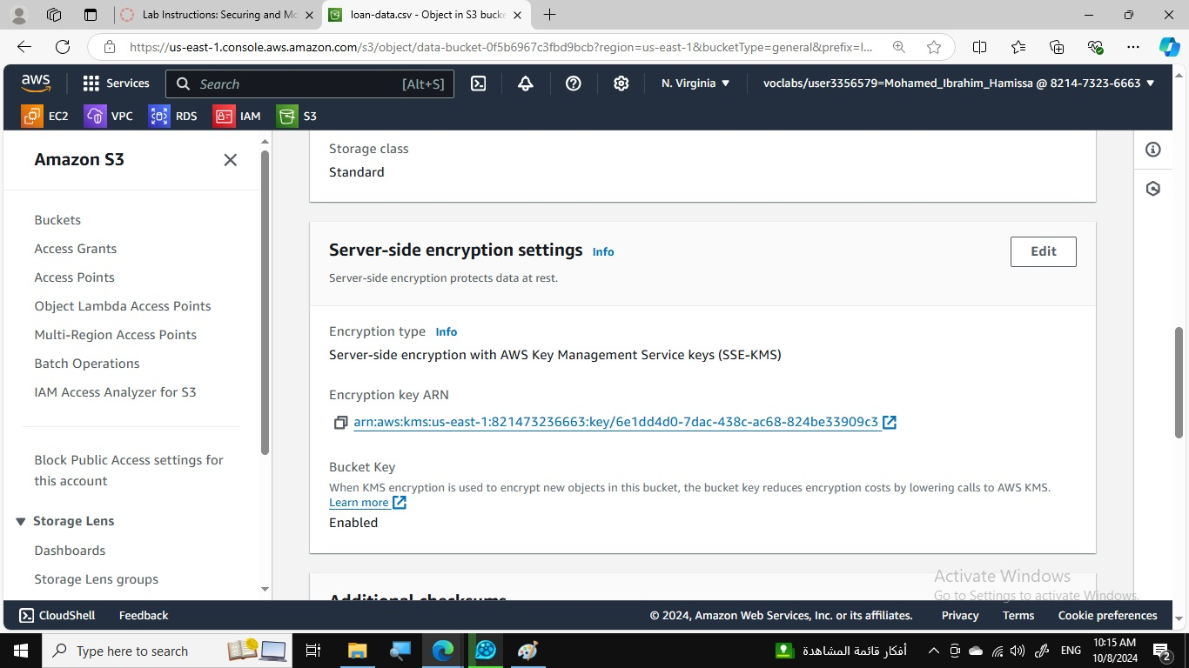
Phase 3: Securing AWS Resources Using AWS KMS

Slide 11
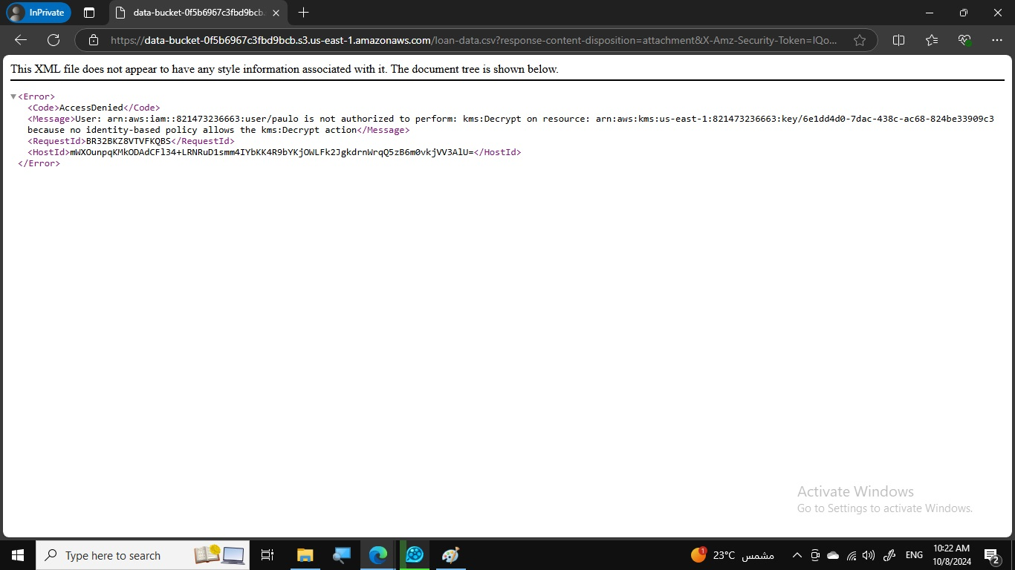
Phase 3: Securing AWS Resources Using AWS KMS

Slide 12
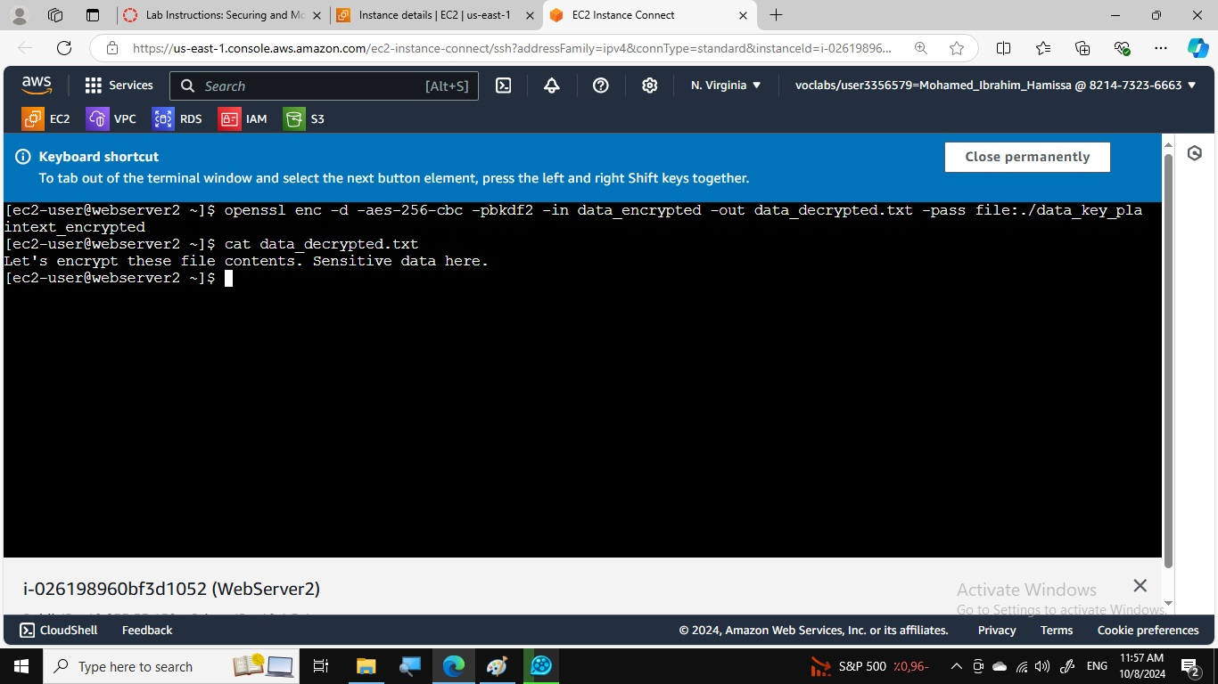
Phase 3: Securing AWS Resources Using AWS KMS
Created an EC2 instance named EncryptedInstance with encrypted root volume.
Generated a data key using AWS KMS.
Encrypted and decrypted the data_unencrypted.txt file using the data key.
(figure)

Slide 13
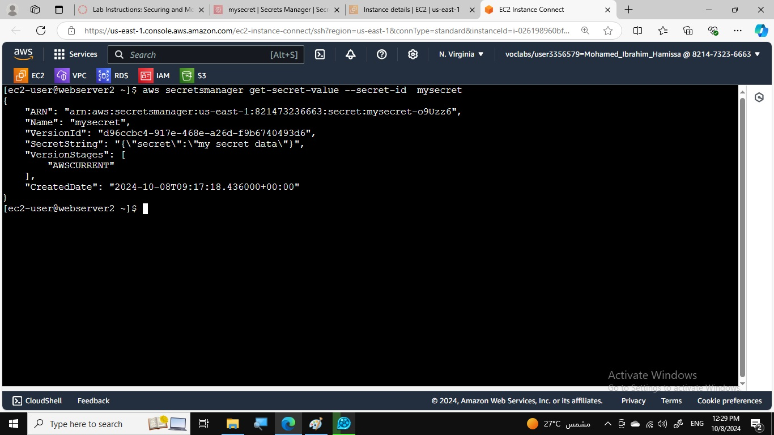
Phase 3: Securing AWS Resources Using AWS KMS
Created a Secrets Manager secret and encrypted it with the KMS key.
Retrieved the secret using the AWS CLI.
(figure)

Slide 14
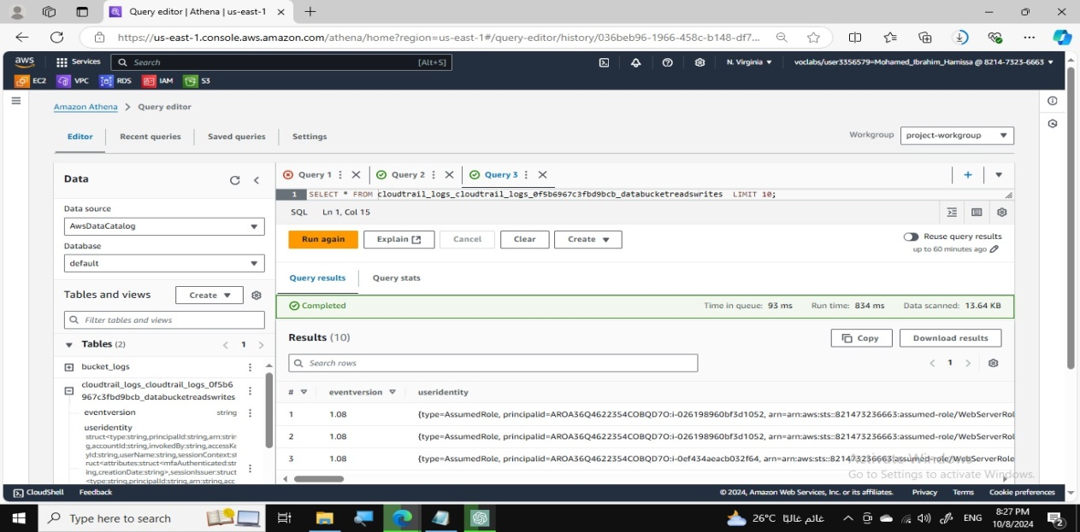
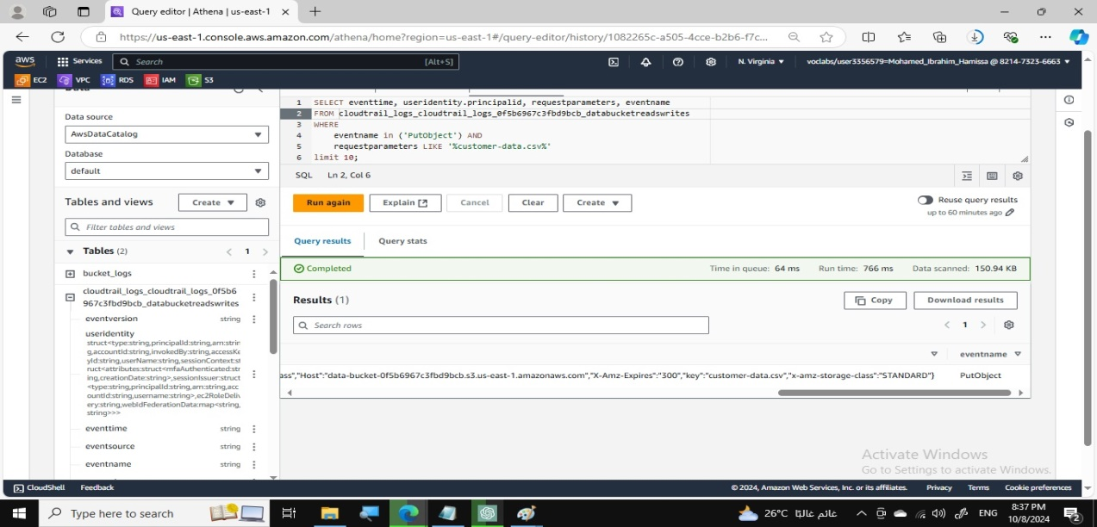
Phase 4: Monitoring and Logging
Created a CloudTrail trail to record S3 API calls.
Created an Athena table to query CloudTrail log data.
(figures)

Slide 15
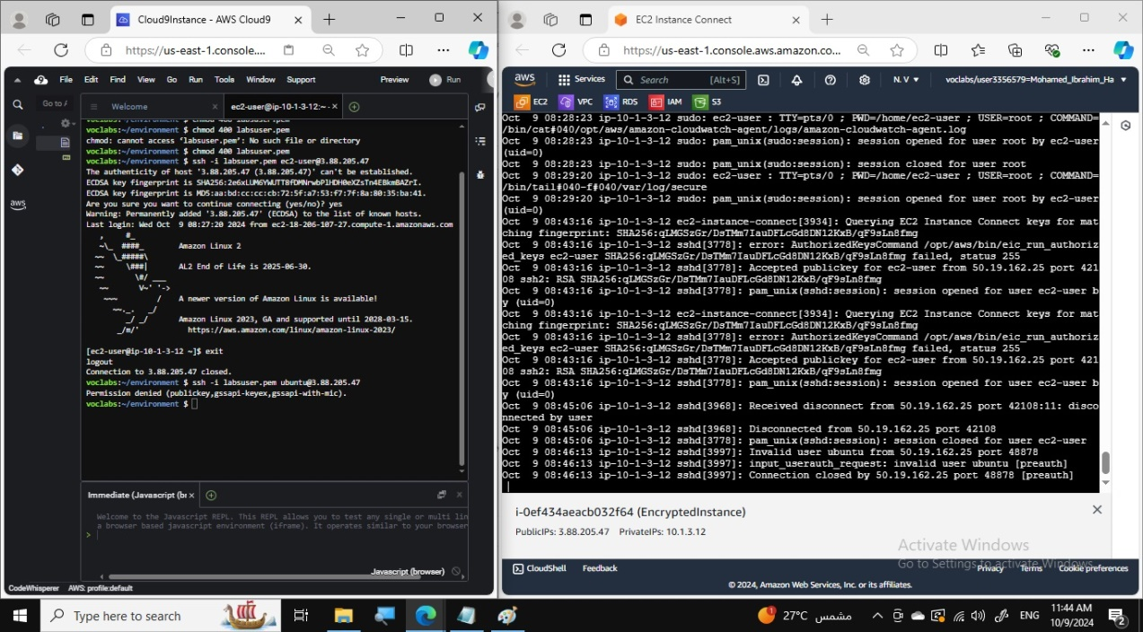
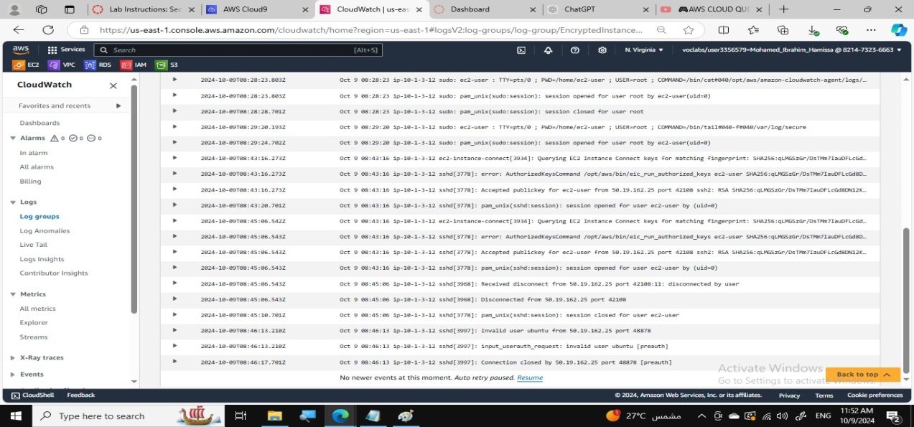
Phase 4: Monitoring and Logging
Configured CloudWatch Logs to monitor secure logs from the EncryptedInstance.
Collected and analyzed SSH access attempts.
(figures)

Slide 16
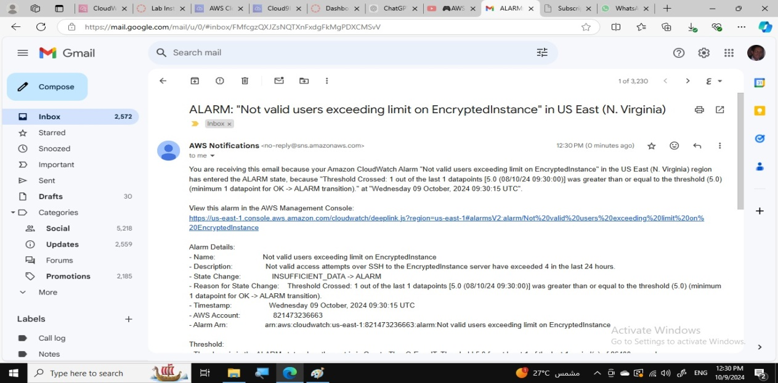
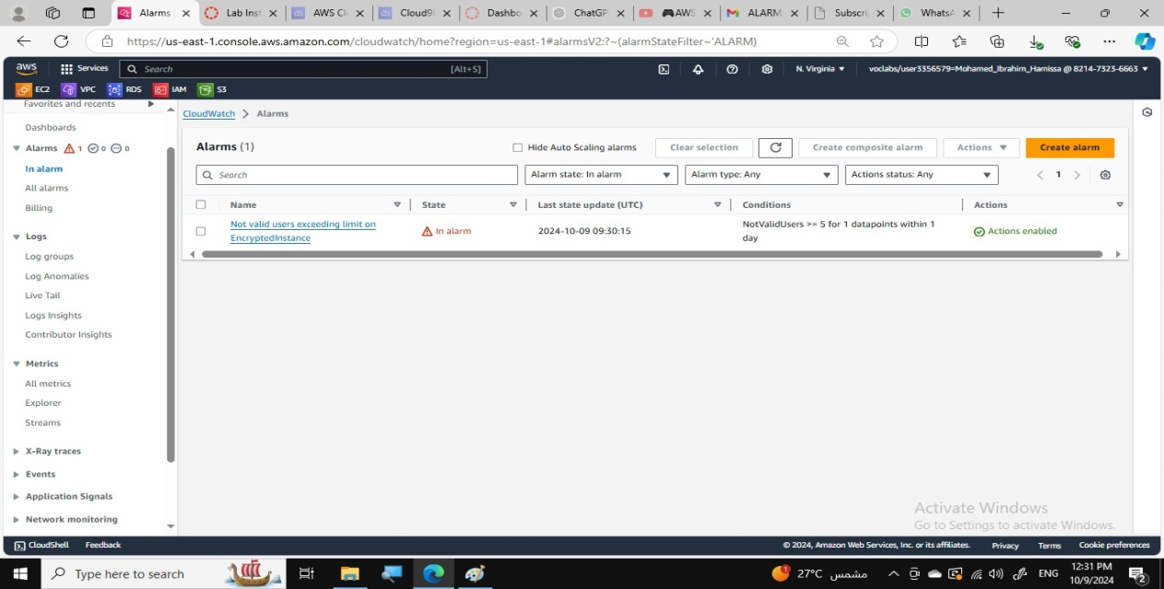
Phase 4: Monitoring and Logging
Created a CloudWatch metric filter to detect invalid user access attempts.
Created a CloudWatch alarm to send notifications when the alarm threshold is met. (figures)
Configured AWS Config to assess security settings for S3 buckets.
Created a remediation action to enable object logging on noncompliant buckets.

Slide 17
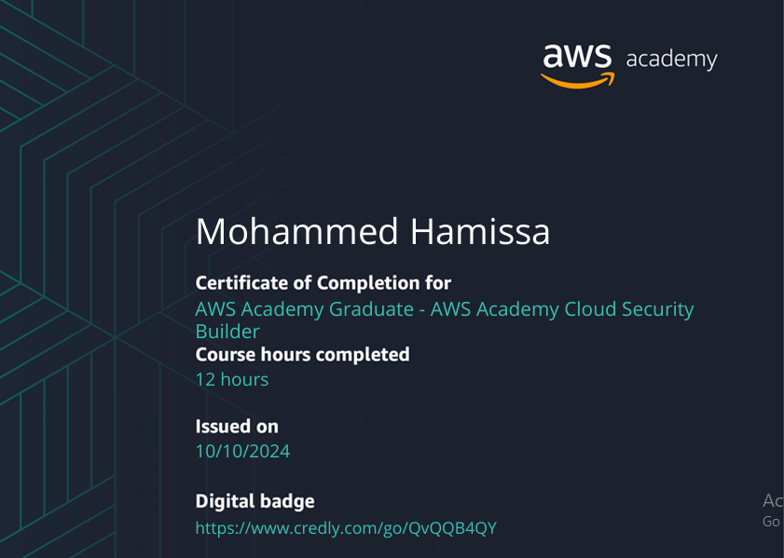
AWS Project: Securing Cloud Resources
Thanks Alot

